Slide 1

IN432
Advanced Web Programming

Slide 2
Forms
What are forms?
  An HTML form is an area of the document that allows users to enter information into fields.
  A form may be used to collect personal information, opinions in polls, user preferences and other kinds of information.

Slide 3
Forms
There are two basic components of a Web form: the shell, the part that the user fills out, and the script which processes the information
HTML tags are used to create the form shell. Using HTML you can create text boxes, radio buttons, checkboxes, drop-down menus, and more...

Slide 4
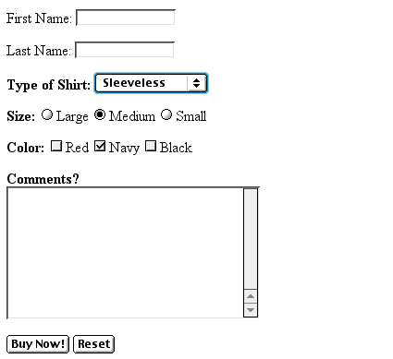
Example: Form
Text Box
Drop-down Menu
Radio Buttons
Checkboxes
Text Area
Reset Button
Submit Button

Slide 5
The Form Shell
A form shell has three important parts:
  the <FORM> tag, which includes the address of the script which will process the form
  the form elements, like text boxes and radio buttons
  the submit button which triggers the script to send the entered information to the server
<form>
.
form elements
.
</form>

Slide 6
Creating the Shell
To create a form shell, type <FORM METHOD=POST ACTION=“script_url”> where “script_url” is the address of the script
Create the form elements
End with a closing </FORM> tag

Slide 7
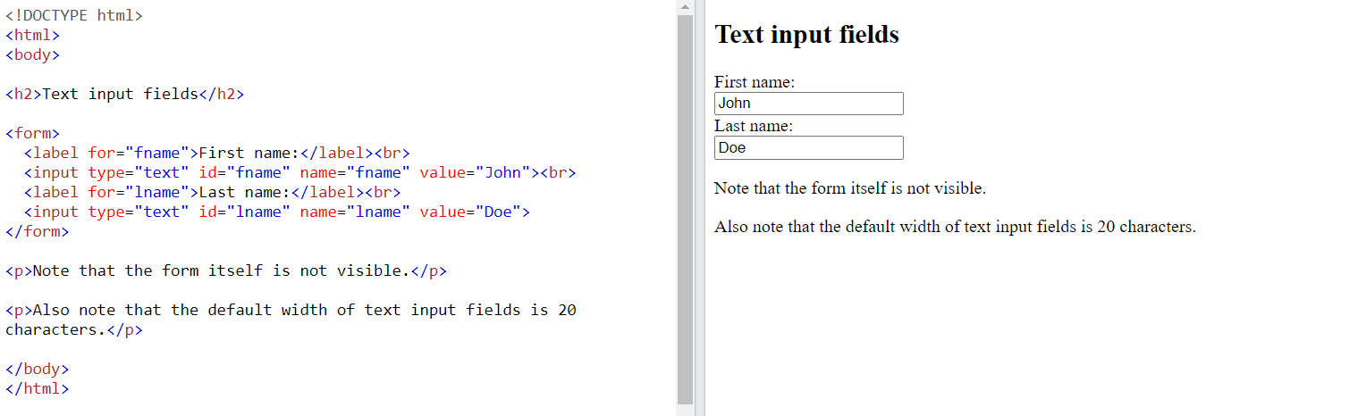
Creating Text Boxes
To create a text box, type <INPUT TYPE=“text” NAME=“name” VALUE=“value” SIZE=n MAXLENGTH=n>
The NAME, VALUE, SIZE, and MAXLENGTH attributes are optional

Slide 8
Text Box Attributes
The NAME attribute is used to identify the text box to the processing script
The VALUE attribute is used to specify the text that will initially appear in the text box
The SIZE attribute is used to define the size of the box in characters
The MAXLENGTH attribute is used to define the maximum number of characters that can be typed in the box

Slide 9

Example: Text Box
First Name: <INPUT TYPE="text" NAME="FirstName" VALUE="First Name" SIZE=20>
<BR><BR>
Last Name: <INPUT TYPE="text" NAME="LastName" VALUE="Last Name" SIZE=20>
<BR><BR>
Here’s how it would look on the Web:

Slide 10
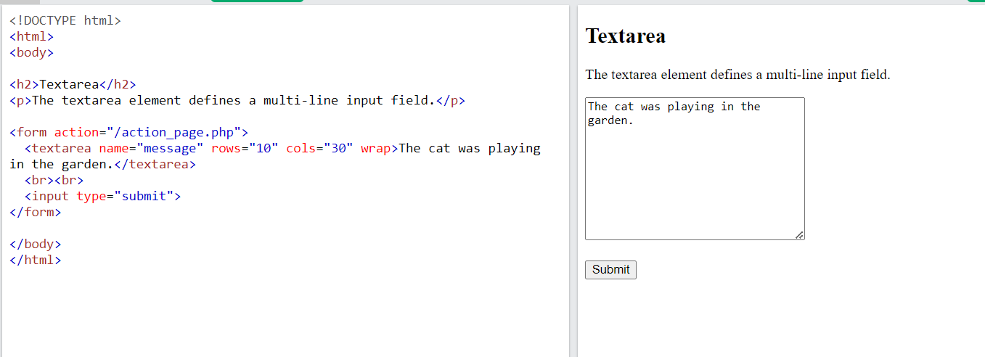
Creating Larger Text Areas
To create larger text areas, type <TEXTAREA NAME=“name” ROWS=n1 COLS=n2 WRAP> Default Text </TEXTAREA>, where n1 is the height of the text box in rows and n2 is the width of the text box in characters
The WRAP attribute causes the cursor to move automatically to the next line as the user types

Slide 11
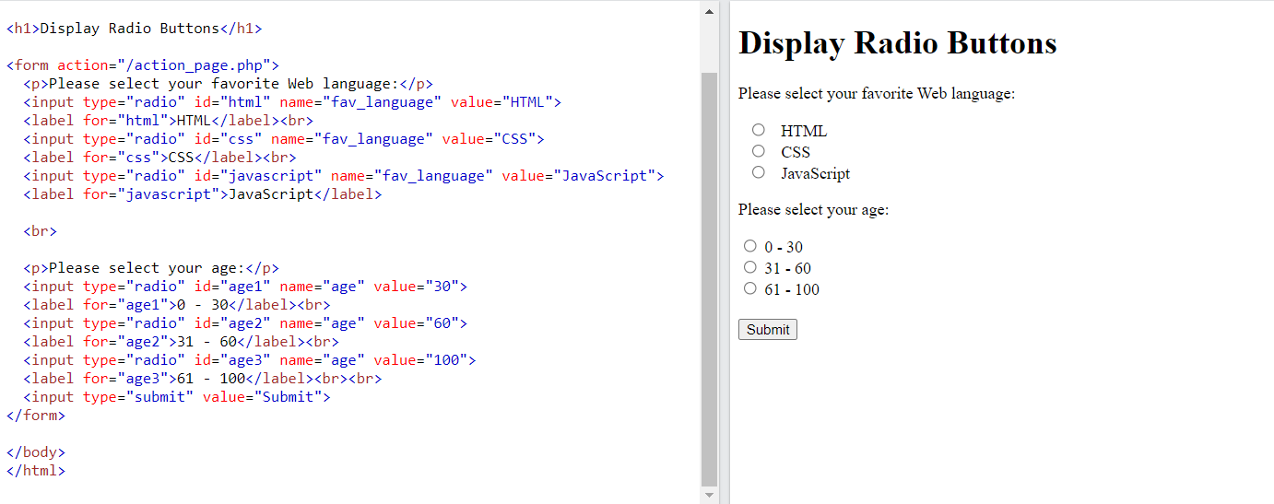
Creating Radio Buttons
To create a radio button, type
<INPUT TYPE=“radio” NAME=“name” VALUE=“data”> Label,
where “data” is the text that will be sent to the server if the button is checked and “Label” is the text that identifies the button to the user

Slide 12
Example: Radio Buttons
<B> Size: </B>
<INPUT TYPE="radio" NAME="Size"
VALUE="Large">Large
<INPUT TYPE="radio" NAME="Size"
VALUE="Medium">Medium
<INPUT TYPE="radio" NAME="Size"
VALUE="Small">Small

Slide 13
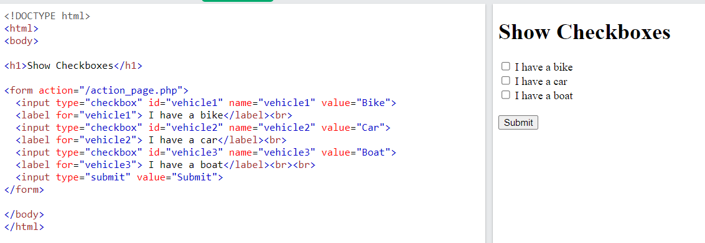
Creating Checkboxes
To create a checkbox, type <INPUT TYPE=“checkbox” NAME=“name” VALUE=“value”>Label
If you give a group of radio buttons or checkboxes the same name, the user will only be able to select one button or box at a time

Slide 14
Example: Checkboxes
<B> Color: </B>
<INPUT TYPE="checkbox" NAME="Color" VALUE="Red">Red
<INPUT TYPE="checkbox" NAME="Color"
VALUE="Navy">Navy
<INPUT TYPE="checkbox" NAME="Color"
VALUE="Black">Black

Slide 15
Creating Drop-down Menus
To create a drop-down menu, type
<SELECT NAME=“name” SIZE=n MULTIPLE>
Then type <OPTION VALUE= “value”>Label
In this case the SIZE attribute specifies the height of the menu in lines and MULTIPLE allows users to select more than one menu option

Slide 16
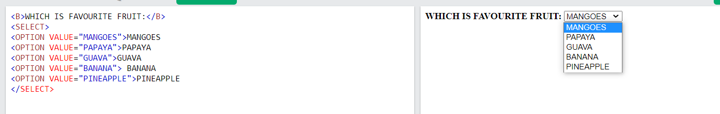
Example: Drop-down Menu

Slide 17
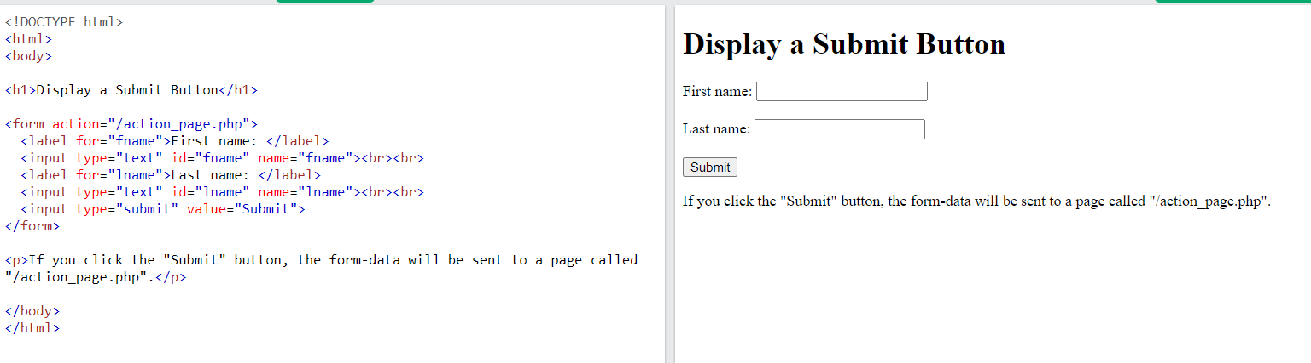
Creating a Submit Button
To create a submit button, type <INPUT TYPE=“submit”>
If you would like the button to say something other than submit, use the VALUE attribute
For example, <INPUT TYPE=“submit” VALUE=“Buy Now!”> would create a button that says “Buy Now!”

Slide 18
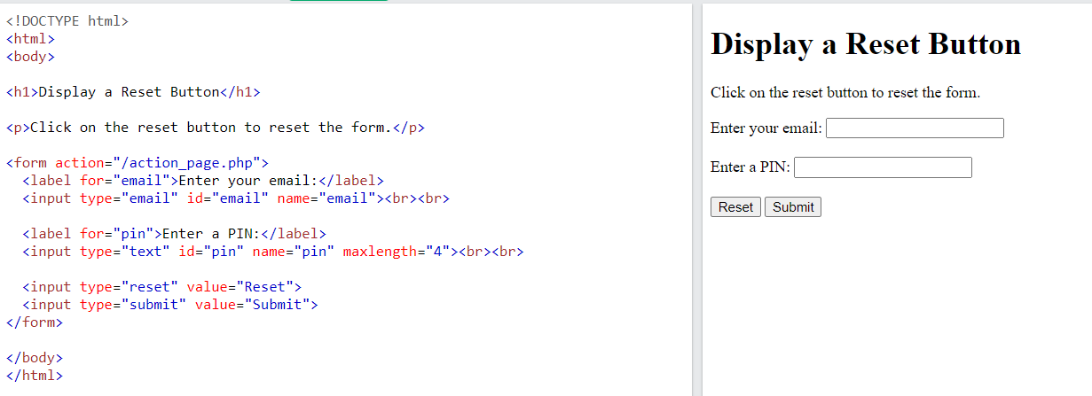
Creating a Reset Button
To create a reset button, type <INPUT TYPE=“reset”>
The VALUE attribute can be used in the same way to change the text that appears on the button

Slide 19
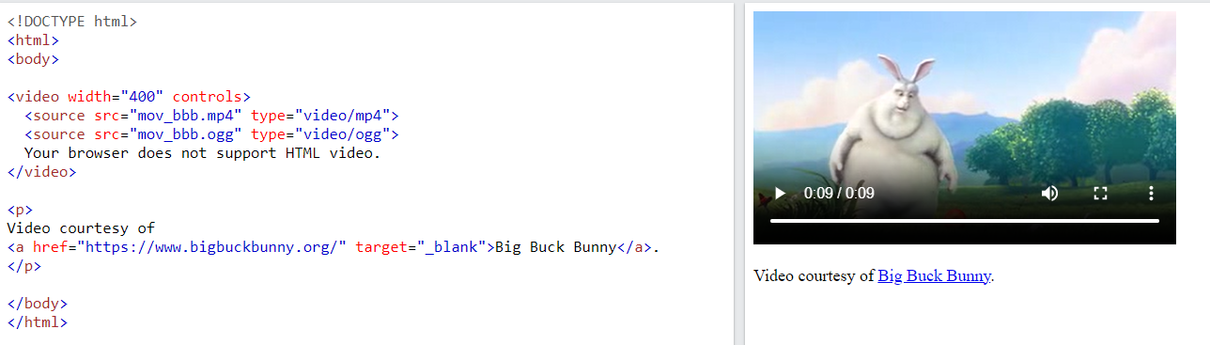
The HTML <video> Element
<video width="320" height="240" controls>
<source src="movie.mp4" type="video/mp4">
<source src="movie.ogg" type="video/ogg">
Your browser does not support the video tag.
</video>

Slide 20
The HTML <video> Element
The controls attribute adds video controls, like play, pause, and volume.
It is a good idea to always include width and height attributes. If height and width are not set, the page might flicker while the video loads.
The <source> element allows you to specify alternative video files which the browser may choose from. The browser will use the first recognized format.
The text between the <video> and </video> tags will only be displayed in browsers that do not support the <video> element.

Slide 21
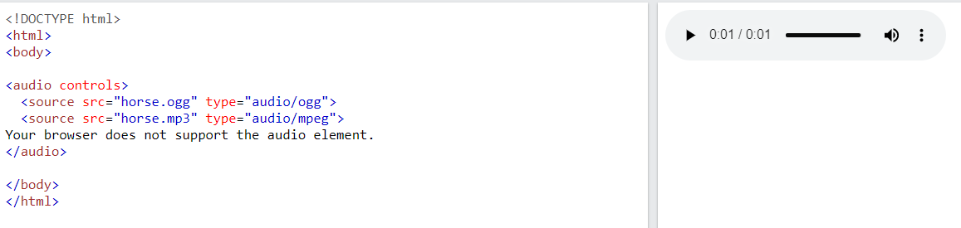
The HTML <audio> Element
<audio controls>
<source src="horse.ogg" type="audio/ogg">
<source src="horse.mp3" type="audio/mpeg">
Your browser does not support the audio element.
</audio>

Slide 22
The HTML <audio> Element
The controls attribute adds audio controls, like play, pause, and volume.
The <source> element allows you to specify alternative audio files which the browser may choose from. The browser will use the first recognized format.
The text between the <audio> and </audio> tags will only be displayed in browsers that do not support the <audio> element.

Slide 23
HTML YouTube Videos
<iframe width="420" height="315"
src="https://www.youtube.com/embed/tgbNymZ7vqY">
</iframe>
YouTube - Autoplay + Muted
<iframe width="420" height="315"
src="https://www.youtube.com/embed/tgbNymZ7vqY?autoplay=1&mute=1">
</iframe>

